Slide 1
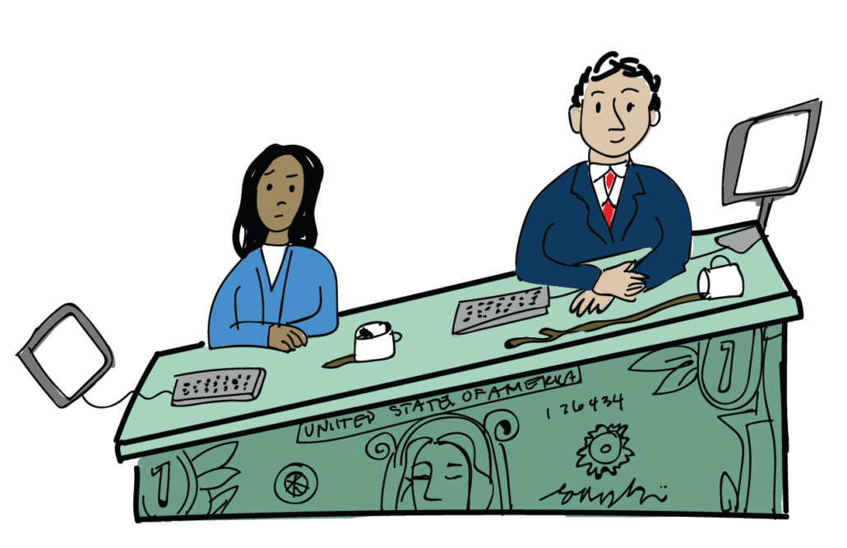
Economics Behind the Gender Wage Gap in the United States
By Nick Przybyla | ECON 145 | CSU Sacramento | 8 May 2023

Slide 2
Rationale
Equity: The gender wage gap represents a significant disparity between men and women's earnings, and closing this gap could help to reduce economic inequality and promote greater social and economic justice
Labor market efficiency: The gender wage gap can also have implications for labor market efficiency, as it can lead to a misallocation of resources and talent. If women are paid less than men for the same work, they may be less likely to pursue careers in certain fields or industries, or may be more likely to leave the workforce altogether
External validity for the topic due to real world application, garnering a lot of attention

Slide 3
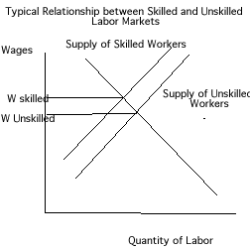
Economic Theory
Selection Bias
Exists in hiring process due to consumer preference
Many people are more likely to go to a male for things like handiwork, women for beauty products, which leads to employers hiring certain genders depending on the occupation
Human Capital Theory
Suggests that the skills, knowledge, and experience that workers acquire over time contribute to their earning potential
Women may earn less than men because they are less likely to invest in education and training due to a variety of factors, including social norms, discrimination, and family responsibilities.

Slide 4
Literature Review
Denning, J. T., Jacob, B. A., Lefgren, L. J., & vom Lehn, C. (2021). The return to hours worked within and across occupations:
Implications for the gender wage gap. ILR Review, 75(5), 1321–1347. https://doi.org/10.1177/00197939211045376
Highlights how hours worked across occupations has a large impact on the gender wage gap
Conclude that while the hours worked by an individual have only a weak relationship with wages, the average hours within an occupation are much more strongly related to wages
10% increase in occupational hours worked is associated with a 10 to 20% increase in wages depending on the specification
Masso, J., Meriküll, J., & Vahter, P. (2022). The role of firms in the gender wage gap. Journal of Comparative Economics, 50(2),
454–473. https://doi.org/10.1016/j.jce.2021.10.001
Covers occupational differences in the gender wage gap in Estonia
Results show firm-level wage premiums, due to the sorting effect and due to women receiving lower wages within the same firm (bargaining effect), can explain as much as 40% of the gender wage gap
Rotman, A., & Mandel, H. (2022). Gender-specific wage structure and the gender wage gap in the U.S. labor market. Social Indicators
Research, 165(2), 585–606. https://doi.org/10.1007/s11205-022-03030-4
Dissects the “unexplained” portion of the gender wage gap (market returns to productivity-enhancing characteristics)
Findings show that the key to understand the gender wage gap lies not in the different characteristics of male and female workers, but mainly in the fact that women are rewarded less than men for their skills

Slide 5
Methodology
Hypothesis: Being female results in a lower hourly wage
Data: Panel data from the PSID
33,398 observations from 1980-2011
Source:
Panel Study of Income Dynamics, public use dataset. Produced and
distributed by the Survey Research Center, Institute for Social
Research, University of Michigan, Ann Arbor, MI (2023).

Slide 6
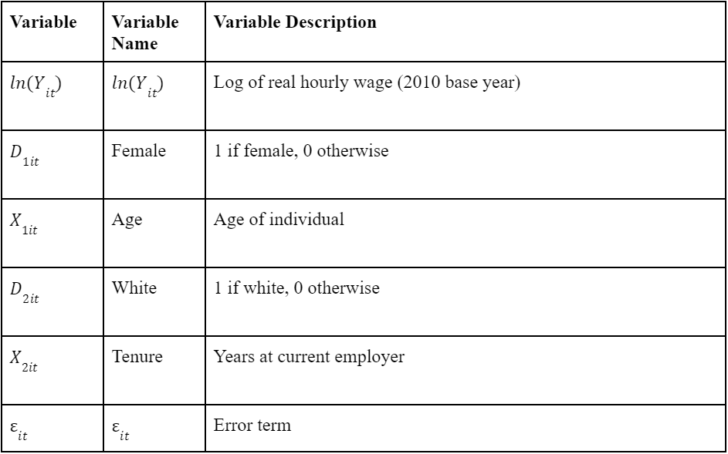
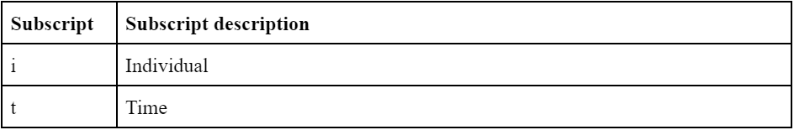
Model
Dependent Variable:
Log of Real Hourly Wage (2010 $)
Independent Variables:
Female
Age
White
Tenure

Slide 7
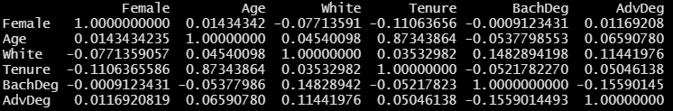
Correlation Matrix
Age and Tenure highly correlated (0.87)
Nothing else highly correlated

Slide 8
Descriptive Statistics
 | Min. | 1st Qua. | Median | Mean | 3rd Qua. | Max.
ln(RealHrWage) | 0.701 | 2.49 | 2.89 | 2.89 | 3.28 | 6.91
Female | 0.00 | 0.00 | 1.00 | 0.51 | 1.00 | 1.00
White | 0.00 | 0.00 | 1.00 | 0.64 | 1.00 | 1.00
BachDeg | 0.00 | 0.00 | 0.00 | 0.19 | 0.00 | 1.00
AdvDeg | 0.00 | 0.00 | 0.00 | 0.09 | 0.00 | 1.00
Tenure | 0.00 | 10.00 | 17.00 | 18.11 | 25.00 | 46.00
TenureSq | 0.00 | 100.0 | 289.0 | 415.9 | 625.0 | 2116.0

Slide 9
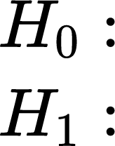
Hausman Test
In R, a Hausman Test was performed to determine if the mixed effect or random effect approach was recommended
Random Effects method is preferred
Fixed Effects method is preferred
p-value < 2.2e-16, therefore, reject the null that the Random Effects method is preferred
Use the Fixed Effects method

Slide 10
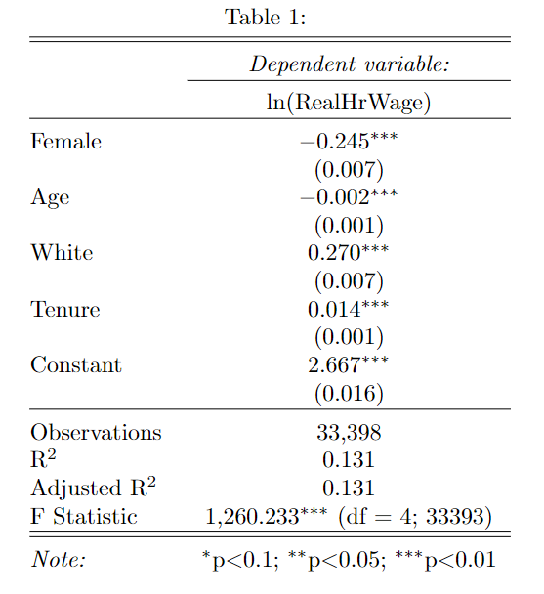
Initial Regression
Results
An unexpected sign on the coefficient of Age indicated there may have been correlation between Age and Tenure
Correlation function in R returned a value of 0.87, confirming high correlation between Age and Tenure
Age was not considered in future regressions
Adjusted R-squared of 0.131

Slide 11
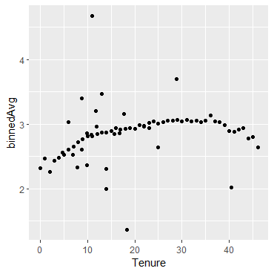
Tenure-squared
Tenure-squared was considered after plotting Tenure against the binned average of ln(RealHrWage)
The plot showed a non-linear relationship with a fall-off towards the end of Tenure

Slide 12
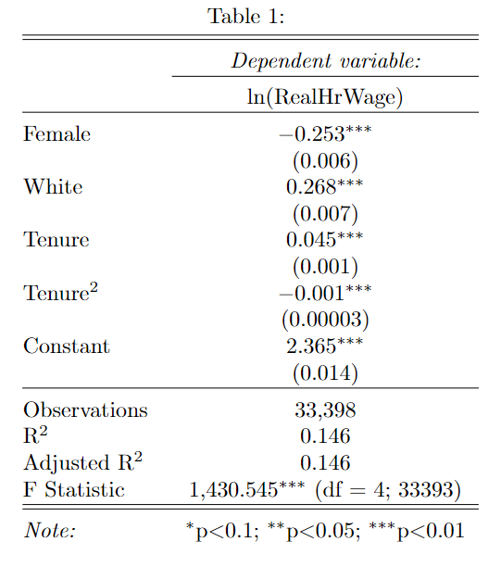
Results Cont.
With the addition of Tenure-squared, the adjusted R-squared increased form 0.131 to 0.146
Negative coefficient indicates the fall-off of real hourly wage near the max of Tenure

Slide 13
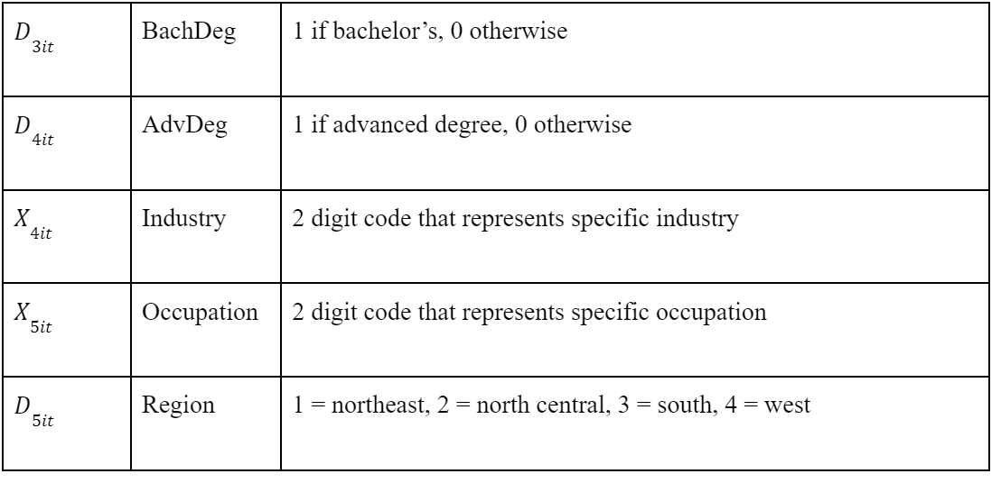
Results Cont.
Controls for college degree and fixed effects for industry, occupation, and region were added
The Industry, Occupation, and Region variables are non-numeric values in R that show the change in hourly wage depending upon what industry, occupation, or region an individual is in

Slide 14
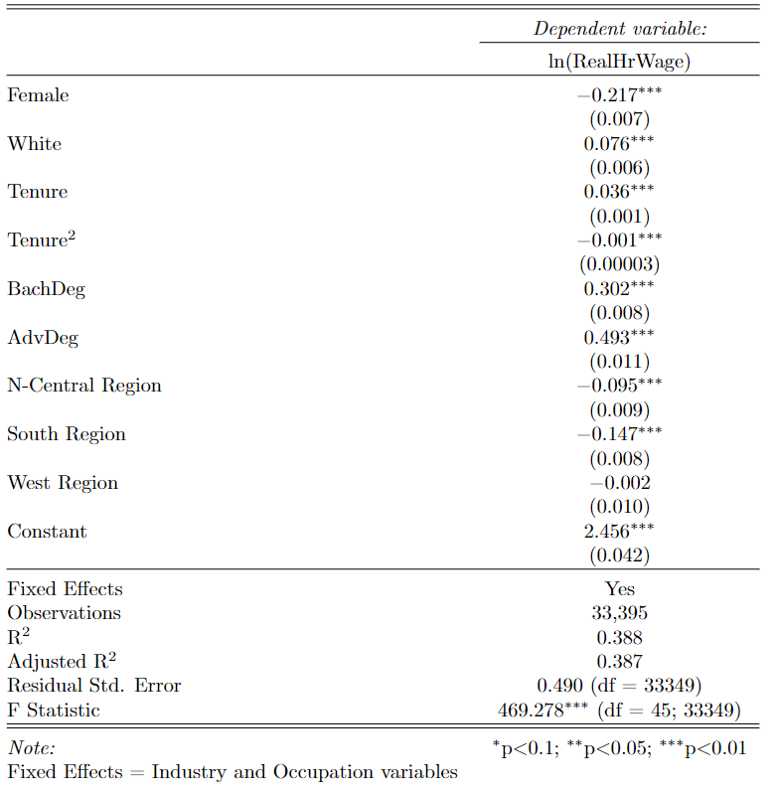
Results Cont.
The addition of BachDeg, AdvDeg, and the Industry, Occupation, and Region fixed effects resulted in an adjusted R-squared of 0.387
Lost 3 observations due to 3 individuals not having data for the Region variable

Slide 15
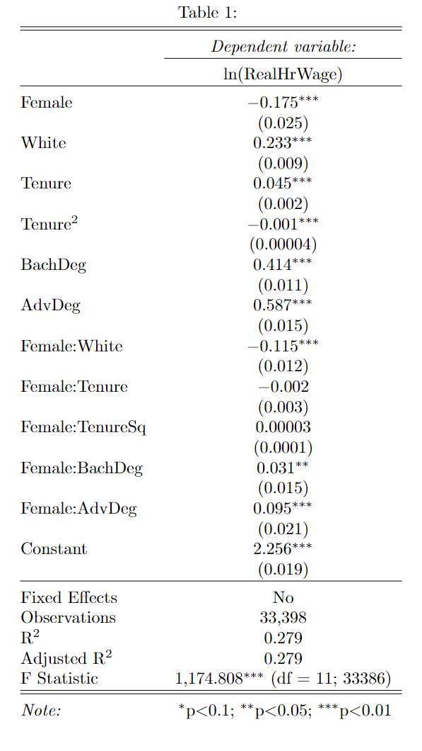
Results Cont.
Female was interacted with 5 control variables
The statistically significant interactions show the change in the log of real hourly wage when someone is both female AND either white, has a bachelor’s degree, or has an advanced degree
The interaction terms capture some of the variation in Y that was previously attributed to the separate variables that Female was interacted with
Female:White shows that if someone is both Female AND White, real hourly wage changes by the coefficients of White, Female, and Female:White combined

Slide 16
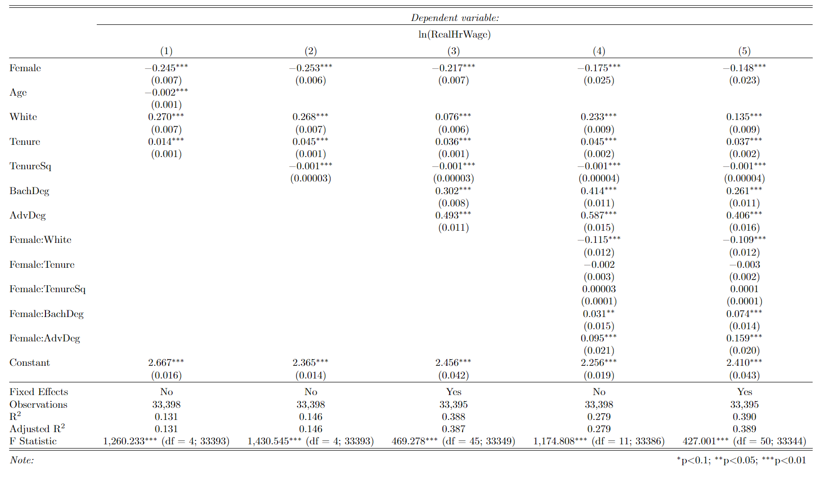
Final Regression Table

Slide 17
Limitations
Would have liked to add more variables
Parental income of individuals
Parental educational attainment
Can only conclude how white women’s income is affected, not other individual races
Lack of experience with the PSID
Hard to locate certain variables due to change in variable names over the years

Slide 18
Policy Implications
Pay transparency
Can help ensure that women are paid fairly compared to their male counterparts
Require companies to report their gender pay gap data
Ensure gender-neutral recruitment and promotion processes
eliminating unconscious biases in job descriptions, interviewing practices, and performance evaluations
Policies that help women with career advancement
Women are often held back in their careers due to maternal responsibilities
Paid family leave
Accessible and affordable childcare
Flexible work arrangements

Slide 19
References
Denning, J. T., Jacob, B. A., Lefgren, L. J., & vom Lehn, C. (2021). The return to hours worked within and across occupations: Implications for the gender wage gap. ILR Review, 75(5), 1321–1347.
https://doi.org/10.1177/00197939211045376
Männasoo, K. (2022). Working Hours and gender wage differentials: Evidence from the American Working Conditions Survey. Labour Economics, 76, 102148.
https://doi.org/10.1016/j.labeco.2022.102148
Masso, J., Meriküll, J., & Vahter, P. (2022). The role of firms in the gender wage gap. Journal of Comparative Economics, 50(2), 454–473. https://doi.org/10.1016/j.jce.2021.10.001
Meara, K., Pastore, F., &amp; Webster, A. (2019). The gender pay gap in the USA: A matching study. Journal of Population Economics, 33(1), 271–305. https://doi.org/10.1007/s00148-019-00743-8
Rahman, M., & Al-Hasan, M. (2022). The reverse gender wage gap in Bangladesh: Demystifying the counterintuitive. The Indian Journal of Labour Economics, 65(4), 929–950.
https://doi.org/10.1007/s41027-022-00402-9
Roche, K. (2017). Millennials and the gender wage gap in the U.S.: A cross-cohort comparison of young workers born in the 1960s and the 1980s. Atlantic Economic Journal, 45(3), 333–350.
https://doi.org/10.1007/s11293-017-9546-6
Rotman, A., & Mandel, H. (2022). Gender-specific wage structure and the gender wage gap in the U.S. labor market. Social Indicators Research, 165(2), 585–606.
https://doi.org/10.1007/s11205-022-03030-4

Slide 20
Thank you!
Any questions?

